Slide 1

2018
Decaying LR
vs
Batch Normalization
Image Lab Summer 2018

Slide 2
2018
1
Decaying Learning Rate
Gradient Descent
Exponential Decay
Sine wave (2017)
Hyperbolic tangent (2018)
Image Lab Summer 2018

Slide 3
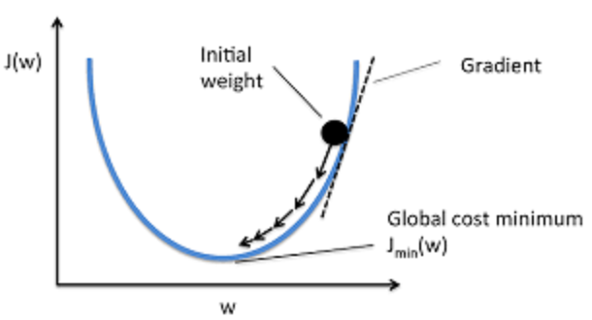

What is Gradient Descent?
2018
Cost Function의 global minumum을 향해 현재 gradient의
반대 방향으로 learning rate 를 설정하는 것.
여기서 등장하는 eta가 학습비율(learning rate)이다.
theta는 파라미터들을 의미한다.
Image Lab Summer 2018

Slide 4
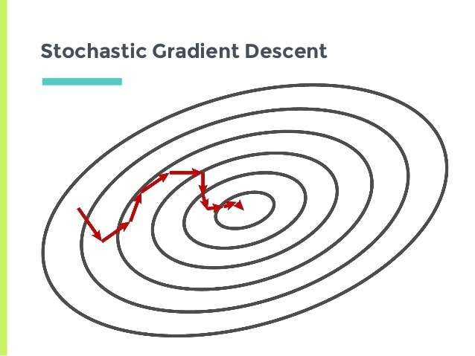
What is Gradient Descent?
2018
Gradient Descent Method 에는 크게 세가지가 있다.
Batch Gradient Descent, Mini-batch Gradient Descent,
그리고 Stochastic Gradient Descent가 그것이다.
데이터들 간의 correlation을 생각하면 굳이 모든 데이터에 대해서
update하지 않아도 된다.
Image Lab Summer 2018

Slide 5
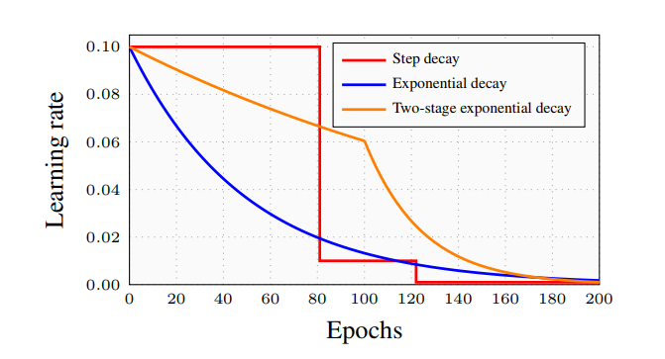
Decay Learning Rate
2018
학습률을 낮추는 방법에는 여러가지가 있다.
가장 간단한 방법은 step decay로, 일정 step마다 학습률을
지정된 수치로 낮춘다.
Image Lab Summer 2018

Slide 6

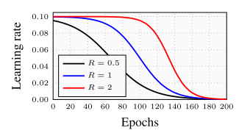
Exponential Decay
2018
e는 step의 수이다.
epoch이 늘어남과 동시에 지수적으로 eta가 감소한다.
논문에선 2-step decay를 활용해 CIFAR10 에서 7.16%의 에러율을 보였다.
Hyperbolic-Tangent Decay
Image Lab Summer 2018

Slide 7
Benefits of Decaying LR
Better Accuracy ▶ If Loss function is convex, it is
obvious to slow down lr.
Faster Converge ▶ Model moves to the right way
2018
Image Lab Summer 2018

Slide 8
Limits of Decaying LR
Learning Speed ▶ May slow down where model is
far away from global minimum
Local Minimum ▶ May fall into local minima
(특히 SGD)
2018
Image Lab Summer 2018

Slide 9
2018
2
Batch Normalization
Gradient Vanishing/Exploding Problem
Internal Covariate Shift
Whitening
Benefits
Image Lab Summer 2018

Slide 10
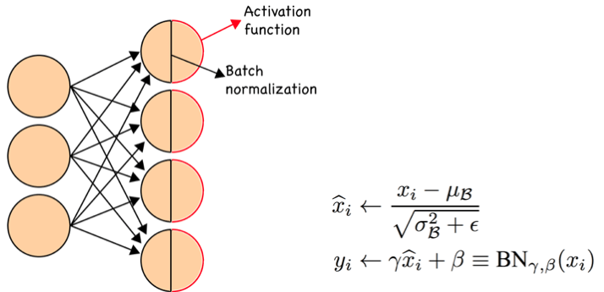
What is Batch Normalization?
2018
입력 데이터들을 일정한 분포를 가지도록 수정하여
training 과정 자체를 전체적으로 안정화하고 학습속도를 가속한다.
Image Lab Summer 2018

Slide 11
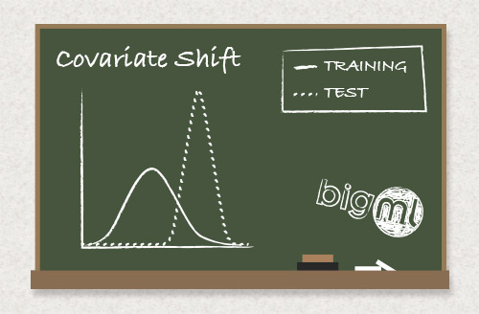
Internal Covariate Shift?
2018
각각의 layer의 parameter들이 현재 layer의 input data 뿐만 아니라 다른
model parameter들에도 영향을 받기 때문에
input의 distribution에 따라 모델의 파라미터들이 영향을 받음.
Image Lab Summer 2018

Slide 12

Whitening
2018
Naïve approach
입력 데이터의 평균을 0, 분산을 1로 normalize 하는 것.
계산량이 많고 데이터가 normalize되면
sigmoid에서 non-linearity 확보가 어려워짐
Image Lab Summer 2018

Slide 13


Batch Normalization
Normalize Input ▶
Correlation ▶
2018
Image Lab Summer 2018

Slide 14
Benefits of BN
Greater LR ▶ No internal covariate shift, not
affected by parameter scaling,
big weight-> small gradient
Faster Converge ▶ Greater LR, regularization
effect (no dropout)
2018
Image Lab Summer 2018

Slide 15
2018
3
Don’t Decay LR,
Increase Batch Size
Scalar to Vector
Affine Transformation
Weighted Sum
Squash Function(non-linearity)
Image Lab Summer 2018

Slide 16
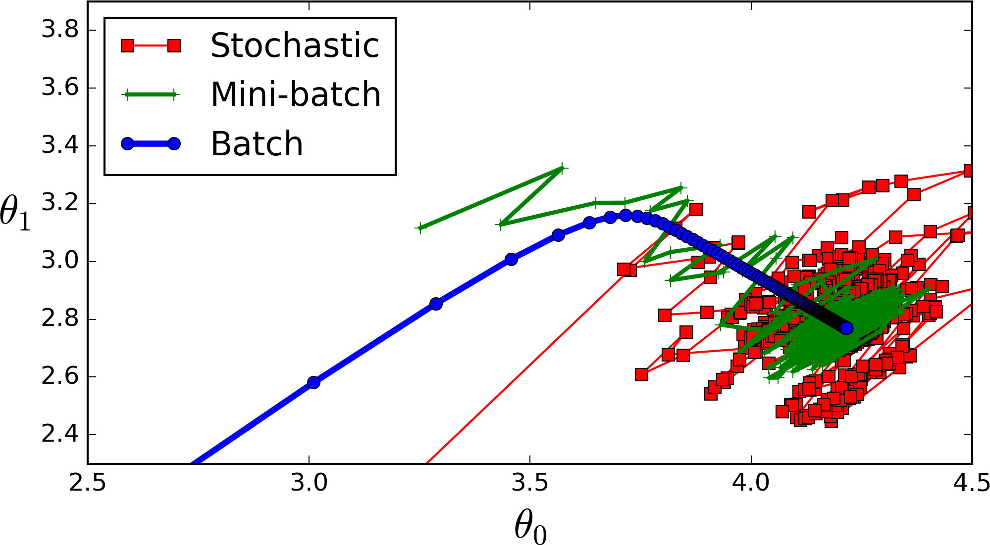
Batch Size?
2018
Number of samples that going to be propagated through the network.
The higher the batch size, the more memory space you'll need.
Image Lab Summer 2018

Slide 17
Why do we use small batch size?
BGD ▶ Millions of calculations for 1 epoch
Memory ▶ Not enough memory to store
whole data
2018
Simulated Annealing
Decay LR ▶ Cosine decay, step-function drops
Image Lab Summer 2018

Slide 18
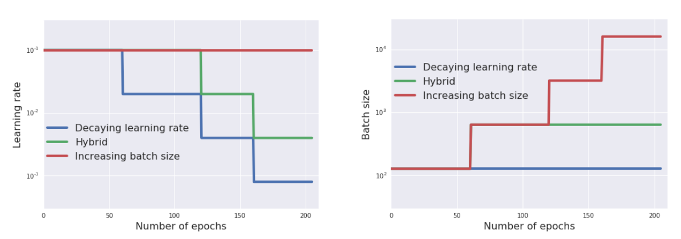
Batch size VS Learning rate
2018
Image Lab Summer 2018

Slide 19
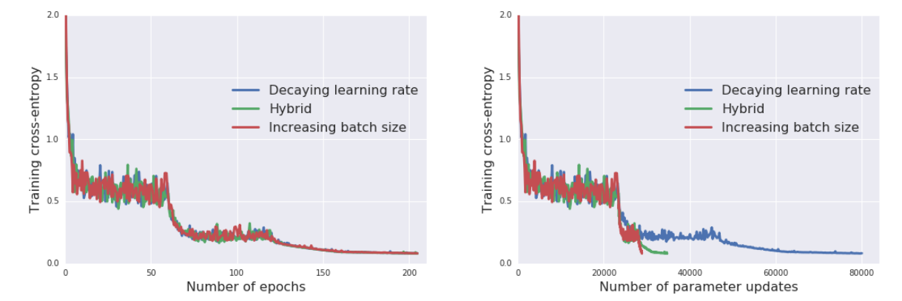
Batch size VS Learning rate
2018
Shows same accuracy.
Image Lab Summer 2018

Slide 20
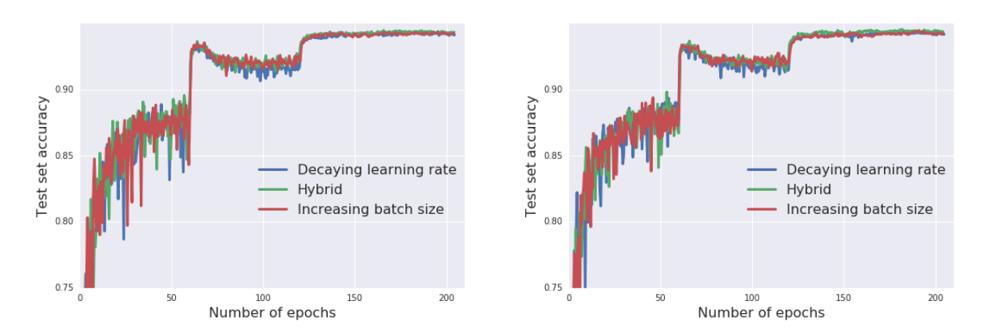
Batch size VS Learning rate
2018
Shows same accuracy.
Image Lab Summer 2018

Slide 21
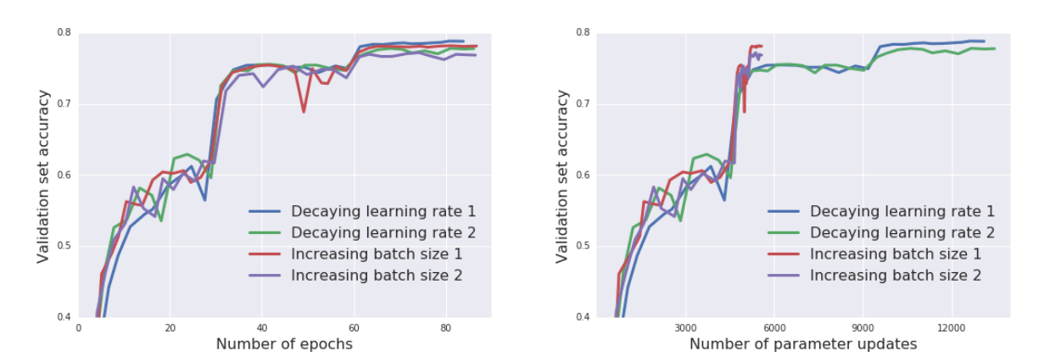
Batch size VS Learning rate
2018
Significantly reduced the number of parameter updates required to
train a model.
It leads to an dramatic reduce of model training time.
Image Lab Summer 2018

Slide 22
Reference
Stochastic Gradient Descent with Hyperbolic-Tangent Decay (arXiv, 2018)
Batch Normalization : Accelerating Deep Network Training by Reducing
Internal Covariate Shift (2015)
Don‘t Decay the Learning Rate, Increase the Batch Size (2017)
2018
Image Lab Summer 2018

Slide 23
2018
감사합니다.
Image Lab Summer 2018

